Slide 1
This slide is hidden.
Insert the starting slides after this slide

Slide 2

Welcome to St Michael’s
25th Sunday in Ordinary Time Year C
Please ensure all mobile phones are switched off.
Please be respectfully quiet as we prepare for our Celebration.
“No one can serve two masters... You cannot serve both God and money.”
Notes:
Saturday 5.30PM First Sunday of Advent
7am - 22nd Sunday in Ordinary Time

Slide 3
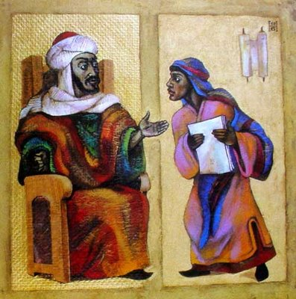
Jesus told his disciples: “There was a rich man whose manager was accused of wasting his possessions.”

Slide 4
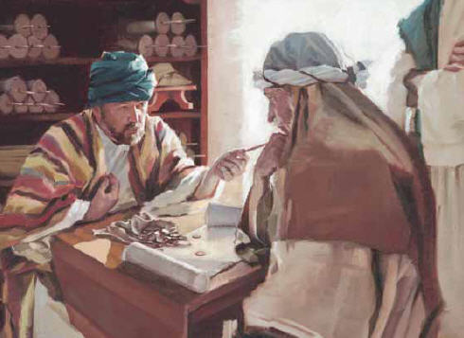
The manager called in all those who owed his master, ‘How much do you owe my master?’ He then told the person to halve the debt?

Slide 5
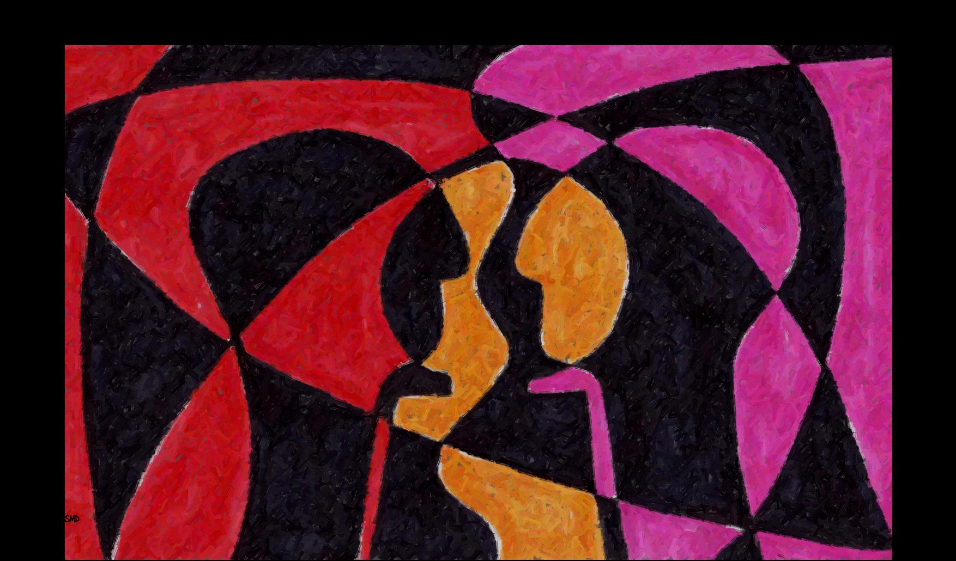
No one can serve two masters...

Slide 6

“Godʼs mercy and care for Godʼs people is to be mirrored by the material care and support of the poor by Godʼs people.”

Slide 7
Please Stand

Slide 8
This slide is hidden.
Insert the Entrance Hymn after this slide

Slide 9
Praise the name of Jesus
Praise the name of Jesus
Praise him as we pray
Praise the name of Jesus
Sing to him all our days

Slide 10
From the rising of the sun
To the setting of the same
The name of the Lord is to be praised
In all things let's praise his name
And so let's

Slide 11
Praise the name of Jesus
Praise him as we pray
Praise the name of Jesus
Sing to him all our days

Slide 12
Let us come unto the Lord
Let us make a joyful noise
He has healed us through his word
In all things let's praise his name
And so let's

Slide 13
Praise the name of Jesus
Praise him as we pray
Praise the name of Jesus
Sing to him all our days
Sing to him all our days

Slide 15
Confiteor
I confess to almighty God
And to you, my brothers and sisters,
That I have greatly sinned
In my thoughts and in my words

Slide 16
In what I have done
And in what I have failed to do,
Through my fault,
Through my fault,
Through my most grievous fault;

Slide 17
Therefore I ask blessed Mary ever-Virgin,
All the Angels and Saints,
And you, my brothers and sisters,
To pray for me to the Lord our God.

Slide 19
Kyrie eleison
Kyrie eleison (2)
Christe eleison (2)
Kyrie eleison (2)

Slide 21
Gloria
Glory to God in the highest,
and on earth peace to people of good will.
We praise you, we bless you,
we adore you, we glorify you,

Slide 22
We give you thanks for your great glory,
Lord, God heavenly king,
O God, almighty father

Slide 23
Glory to God in the highest,
and on earth peace to people of good will.

Slide 24
Lord Jesus Christ, Only Begotten Son,
Lord God, Lamb of God, Son of the Father,
you take away the sins of the world,
have mercy on us;

Slide 25
you take away the sins of the world, receive our prayer;
you are seated at the right hand of the Father,
have mercy on us.

Slide 26
Glory to God in the highest,
and on earth peace to people of good will.

Slide 27
For you alone are the Holy One,
you alone are the Lord,
you alone are the Most High, Jesus Christ,
with the Holy Spirit,
in the glory of God the Father.

Slide 28
Glory to God in the highest,
and on earth peace to people of good will.
Amen.

Slide 30
Responsorial Psalm
Praise the Lord who lifts up the poor.

Slide 32
Alleluia
Alleluia, alleluia,
alleluia, alleluia

Slide 34
Apostles Creed
I believe in God,
the Father almighty,
Creator of heaven and earth,
and in Jesus Christ, his only Son, our Lord,
(At the words that follow, up to and including the Virgin Mary, all bow.)

Slide 35
who was conceived by the Holy Spirit,
born of the Virgin Mary,
suffered under Pontius Pilate,
was crucified, died and was buried;
he descended into hell;

Slide 36
on the third day he rose again from the dead;
he ascended into heaven,
and is seated at the right hand of God the Father almighty;

Slide 37
from there he will come to judge the living and the dead.
I believe in the Holy Spirit,
the holy catholic Church,

Slide 38
the communion of saints,
the forgiveness of sins,
the resurrection of the body,
and life everlasting.
Amen.

Slide 40
First Collection
This collection goes to the Bishop
for the support of the Diocese.
Thank you for your contribution

Slide 42
This slide is hidden.
Insert the Offertory Hymn after this slide.

Slide 43
Blessed be God
Blessed are you Lord God or all creation
Thanks to your goodness this bread we offer
Fruit of the earth, work of our hands
It will become the bread of life

Slide 44
Blessed be God, blessed be God
Blessed be God forever amen.
Blessed be God, blessed be God
Blessed be God forever amen

Slide 45
Blessed are you Lord, God of all creation
Thanks to your goodness this wine we offer
Fruit of the vine, work of our hands
It will become the cup of joy

Slide 46
Blessed be God, blessed be God
Blessed be God forever amen.
Blessed be God, blessed be God
Blessed be God forever amen

Slide 48
Priest: Pray my brothers and sisters,
that my sacrifice and yours may be
acceptable to God, the almighty Father.
All: May the Lord accept the sacrifice
at your hands for the praise and glory of his name, for our good and the good of all his holy Church.

Slide 49
Priest: The Lord be with you.
All: And with your spirit.
Priest: Lift up your hearts.
All: We lift them up to the Lord.

Slide 50
Priest: Let us give thanks to the
Lord our God.
All: It is right and just.

Slide 52
Holy
Holy, Holy, Holy Lord God of hosts,
Heaven and earth are full of your glory. Hosanna in the highest
Blessed is he who comes
in the name of Lord,
Hosanna in the highest.

Slide 54
Memorial acclamation
Save us saviour of the world,
For by your cross and resurrection,
You have set us free

Slide 55
Memorial acclamation
When we eat this bread
And drink this cup
We proclaim your death O Lord
Until you come again

Slide 56
Memorial acclamation
We proclaim your death O Lord
And profess your resurrection
Until you come again

Slide 58
Amen
Amen, amen, amen, amen.
Amen, amen, amen, amen.

Slide 60
Priest: The Lord be with you.
All: And with your spirit

Slide 62
Peace
May the peace of the Lord be with you
With your friends and your family too
Let it be, let it grow
And everywhere you go
May the peace of the Lord follow you

Slide 63
Lamb of God
Lamb of God, lamb of God
You take away the sins of the world
Have mercy on us, lamb of God

Slide 64
Lamb of God, lamb of God
You take away the sins of the world
Have mercy on us, lamb of God

Slide 65
Lamb of God, lamb of God
You take away the sins of the world
Grant us, grant us peace

Slide 67
All: Lord, I am not worthy
that you should enter under my roof,
but only say the word
and my soul shall be healed.

Slide 69
Priest: Behold the Lamb of God, behold him
who takes away the sins of the world.
Blessed are those called to the supper of the Lamb.
All: Lord, I am not worthy
that you should enter under my roof,
but only say the word
and my soul shall be healed.

Slide 70
This slide is hidden.
Insert the Communion Hymns after this slide.

Slide 71
This is my body
This is my body, broken for you
Bringing forgiveness, making you free
Take it and eat it, and when you do,
Do it in love for me

Slide 72
This is my blood, poured out for you
Bringing you wholeness, making you free
Take it and drink it, and when you do
Do it in love for me

Slide 73
Take and eat
Take and eat, take and eat,
This is my body given up for you.
Take and drink, take and drink,
This is my blood given up for you.

Slide 74
I am the Word that spoke
and light was made;
I am the seed that died to be reborn;

Slide 75
I am the bread that comes
from heaven above;
I am the vine that fills
your cup with joy.

Slide 76
Take and eat, take and eat
This is my body given up for you
Take and drink, take and drink
This is my blood, given up for you

Slide 77
I am the Lamb that takes away your sin;
I am the gate that
guards you night and day.

Slide 78
You are my flock;
you know the shepherd’s voice.
You are my own;
your ransom is my blood

Slide 79
Take and eat, take and eat
This is my body given up for you
Take and drink, take and drink
This is my blood, given up for you

Slide 80
I am the light that came into the world
I am the light
that darkness cannot hide;

Slide 81
I am the morning star that never sets;
Lift up your face,
in you my light will shine

Slide 82
Take and eat, take and eat
This is my body given up for you
Take and drink, take and drink
This is my blood, given up for you

Slide 83
Make me like you
Lord, make me like you,
Please make me like you.
You are a servant
Make me one too.

Slide 84
O Lord, I am willing,
Do what you must do
To make me like you Lord.
Please make me like you.

Slide 85
Lord, make me like you,
Please make me like you.
You are a servant
Make me one too.

Slide 86
O Lord, I am willing,
Do what you must do
To make me like you Lord.
Please make me like you.

Slide 87
Second Collection
What you contribute now
is for the support of our
parish and its mission.
Thank you for your generosity

Slide 88
This slide is hidden.
Insert the Notices for the week after this slide

Slide 89

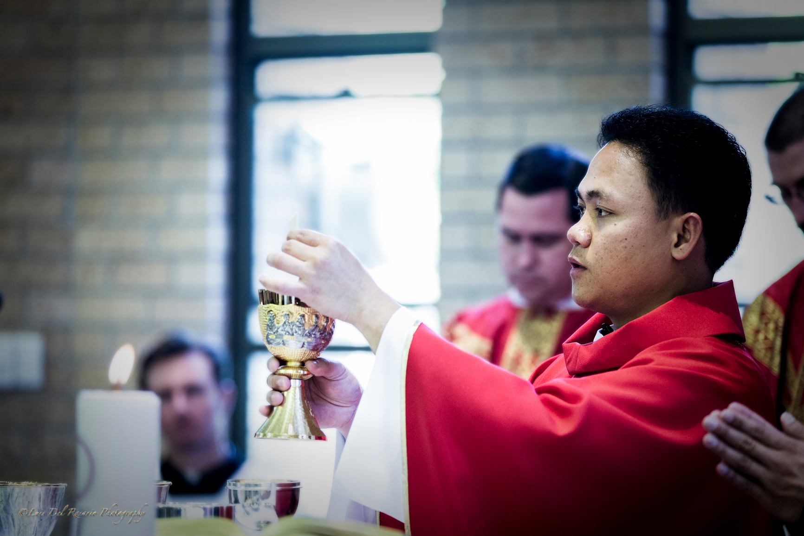
Next Sunday 9.30am 29th Sep
Please bring a plate!

Slide 90
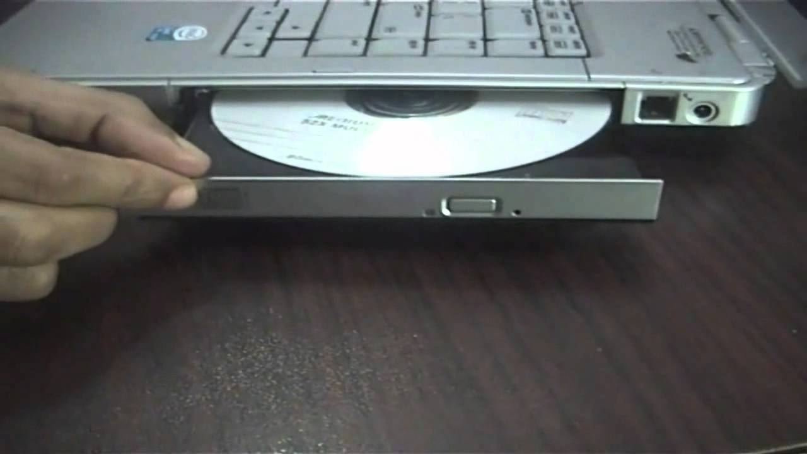
Helpers for non-choir Masses to operate DVD and computer
7th October, 7pm
Notes:
Volunteers willing to use the computer during Mass to display powerpoint and DVD are invited to attend an information evening on the 7th October 7pm. Contact Paul Scott or just turn up on the night.

Slide 91

The SVDP pantry needs to restock the following items:
Long life milk, Biscuits, 2 min noodles, Cereal and Baked Beans
Many thanks for your support

Slide 92

Please take home your bulletins or download it from
www.stmichaelsparish.com
  www.facebook.com/
  blacktowncatholics

Slide 93
This slide is hidden.
The next slide can be used for videos.
Insert the video into the slide.

Slide 95
Priest: The Lord be with you.
All: And with your spirit.

Slide 97
This slide is hidden.
Insert the Recessional Hymns after this slide.

Slide 98
Shine Jesus shine
Lord, the light of your love is shining
In the midst of the darkness, shining
Jesus, Light of the world, shine upon us
Set us free by the truth you now bring us
Shine on me, shine on me

Slide 99
Shine, Jesus, shine
Fill this land with the Father's glory
Blaze, Spirit, blaze
Set our hearts on fire

Slide 100
Flow, river, flow
Flood the nations with grace & mercy
Send forth your word
Lord, and let there be light

Slide 101
Lord, I come to your awesome presence
From the shadows into your radiance
By the blood I may enter your brightness
Search me, try me, consume all my darkness
Shine on me, shine on me

Slide 102
Shine, Jesus, shine
Fill this land with the Father's glory
Blaze, Spirit, blaze
Set our hearts on fire

Slide 103
Flow, river, flow
Flood the nations with grace & mercy
Send forth your word
Lord, and let there be light

Slide 104
“Godʼs mercy and care for Godʼs people is to be mirrored by the material care and support of the poor by Godʼs people.”

Slide 105
This slide is hidden.
Insert the final slide here.

